Slide 1
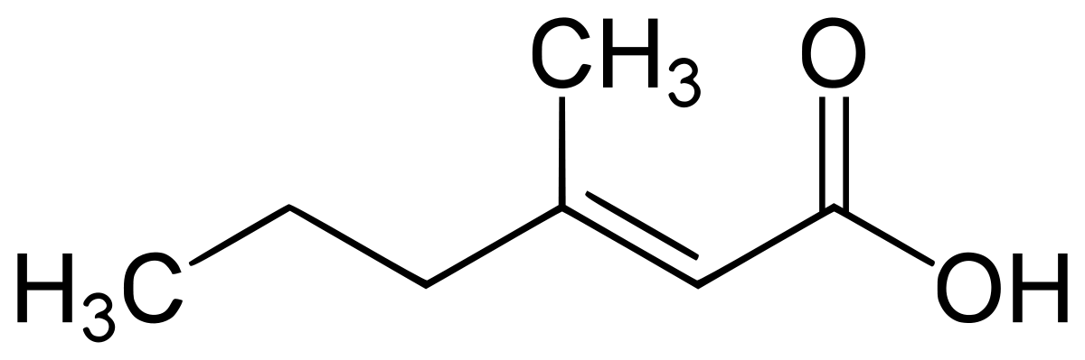
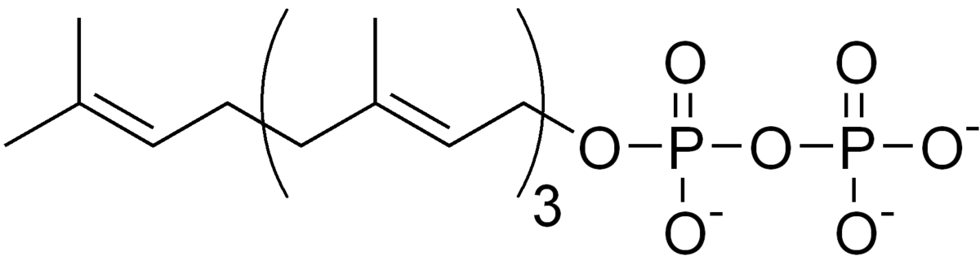
Extraction of
Biosynthetic Pathways
from Images
Anubhab Chakraborty

Slide 2
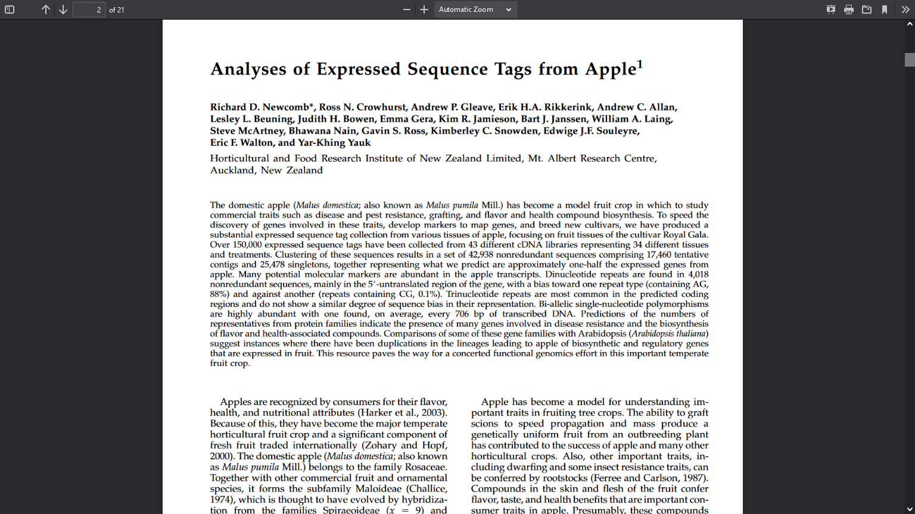

Slide 3
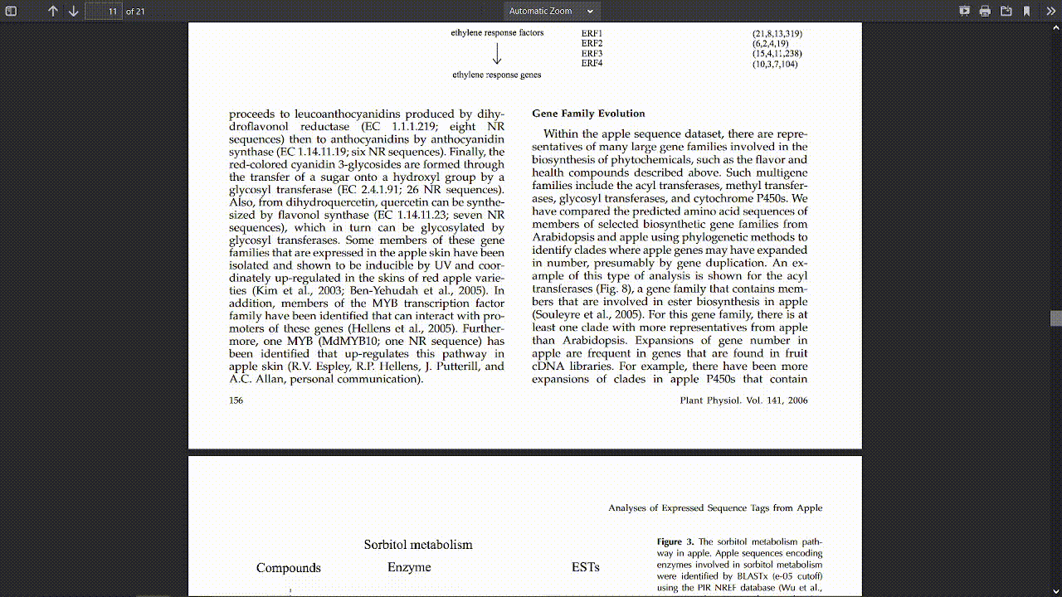

Slide 4
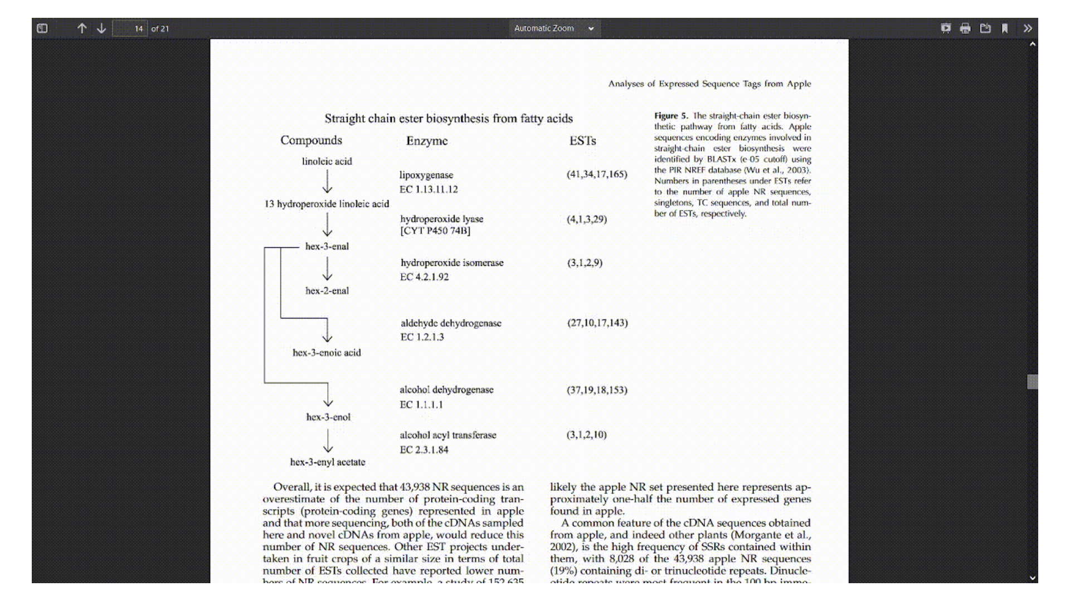

Slide 5

Premise
Useful scientific information is often locked up in images in scientific papers
Currently you need a human to read and interpret the diagrams
Our goal with pyamiimage is to read such images and extract useful semantic information from the images automatically!
Right now we are working on biosynthetic pathways
IMAGE

Slide 6





IMAGE
CML
Chemical Markup Language

Slide 7
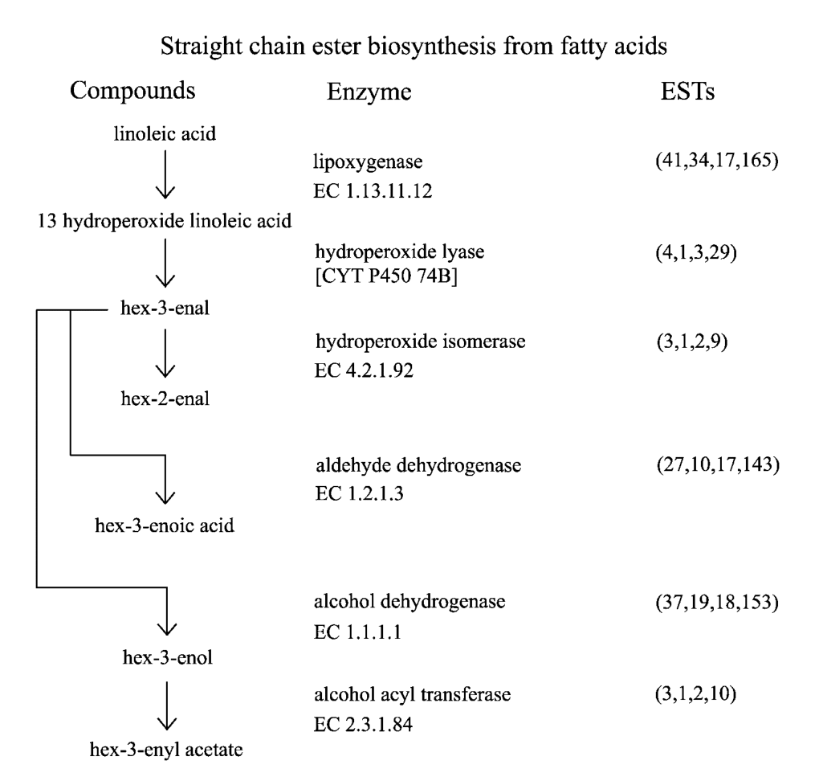
A biosynthetic pathway image found in literature
This is a DUMB document
Just pixels, only humans can read and understand it
Let’s try to make it smarter
Extract text with Tesseract

Slide 8
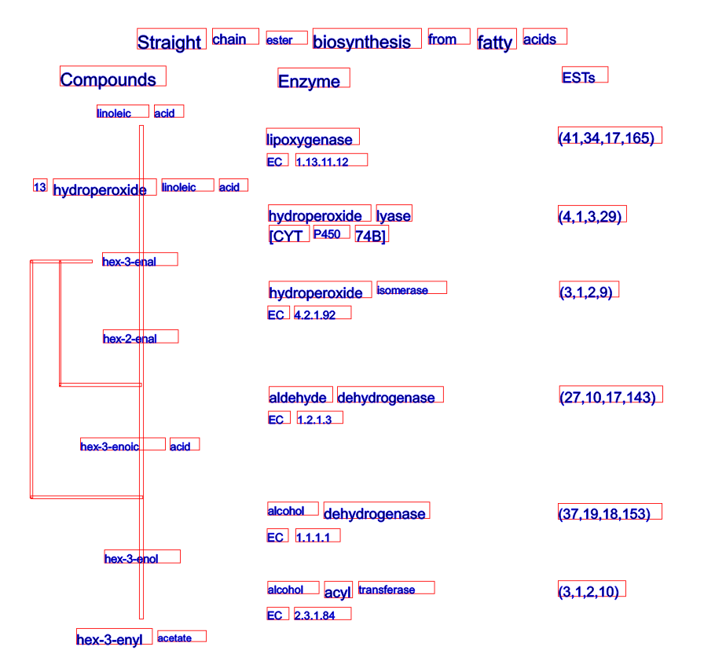
SVG
Pixels
SVG from Tesseract output
Tesseract recognises text in the whole image

Slide 9


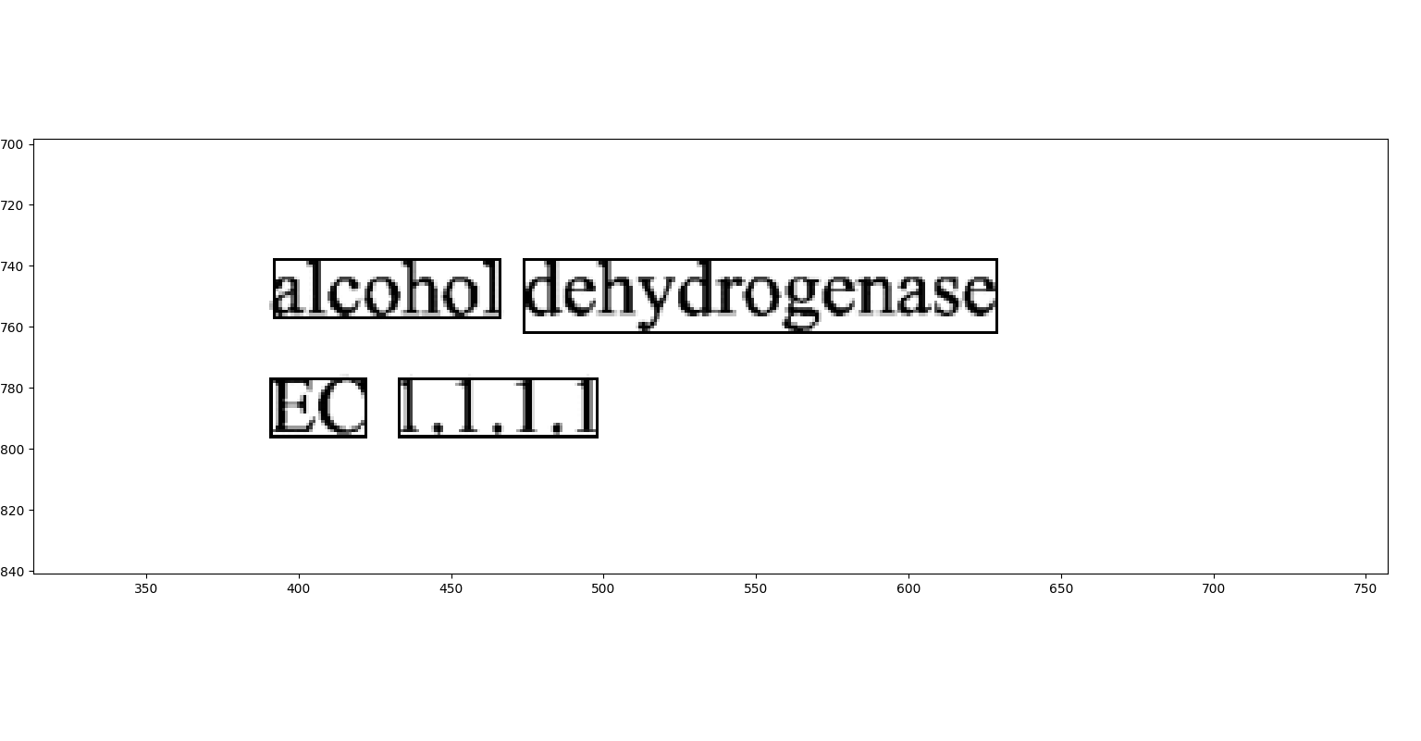
tesseract-ocr / tesseract
<span class="ocr_line" id="line_1_25" title="bbox 392 738 629 762; baseline 0 -5; x_size 24; x_descenders 5; x_ascenders 6"> <span class="ocrx_word" id="word_1_45" title="bbox 392 738 466 757; x_wconf 96">alcohol</span> <span class="ocrx_word" id="word_1_46" title="bbox 474 738 629 762; x_wconf 96">dehydrogenase</span> </span>

Slide 10
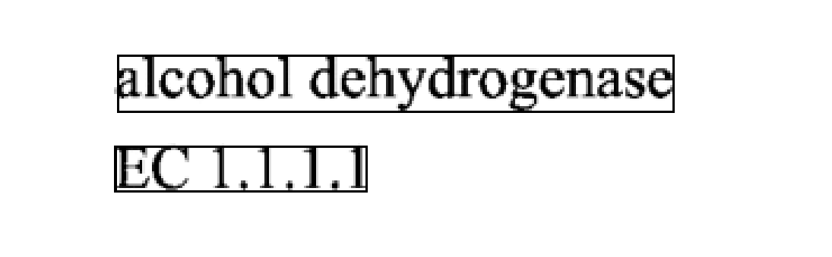
Geometric Phrase Detection
Words:
IMAGE
Phrases:

Slide 11
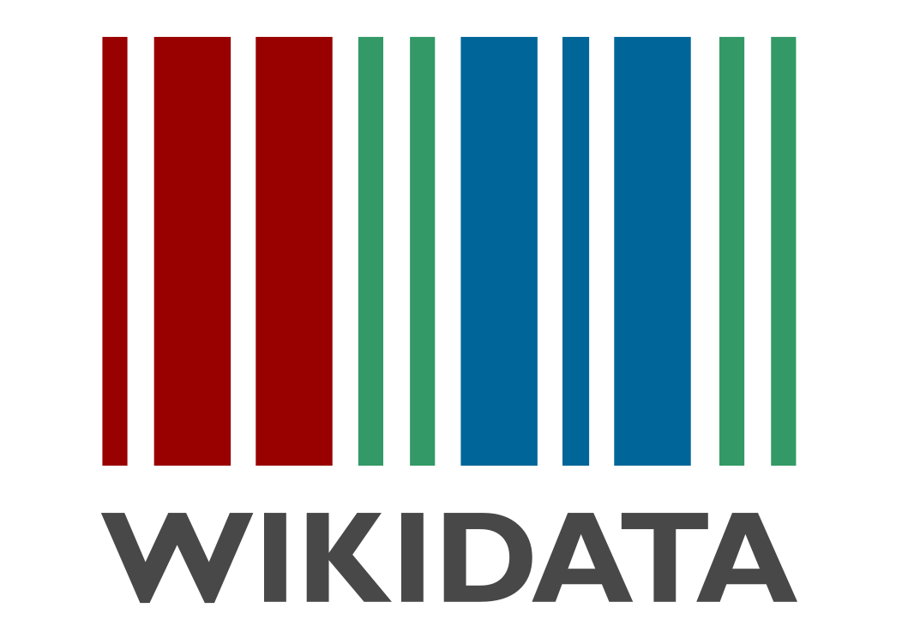
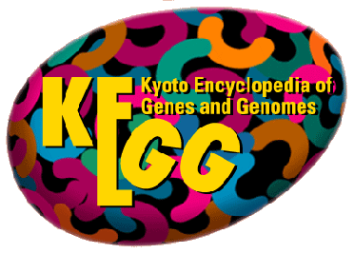
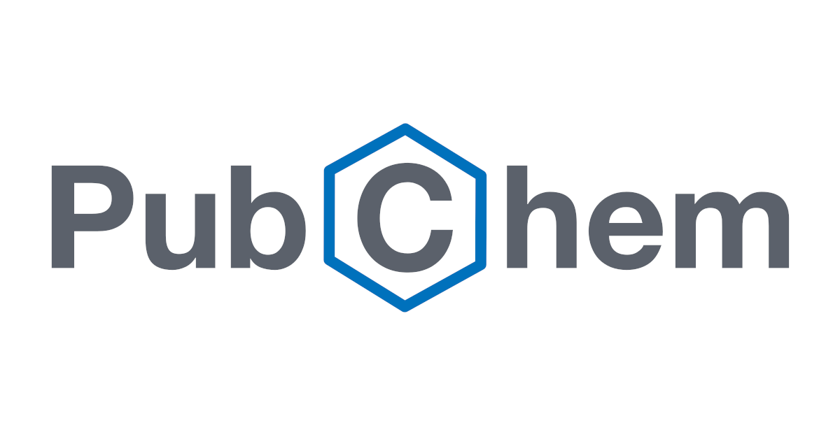
Wikidata/KEGG/PubChem Lookup
IMAGE
Wikidata
https://www.wikidata.org/wiki/Q410754
KEGG
https://www.genome.jp/entry/1.1.1.1

Slide 12
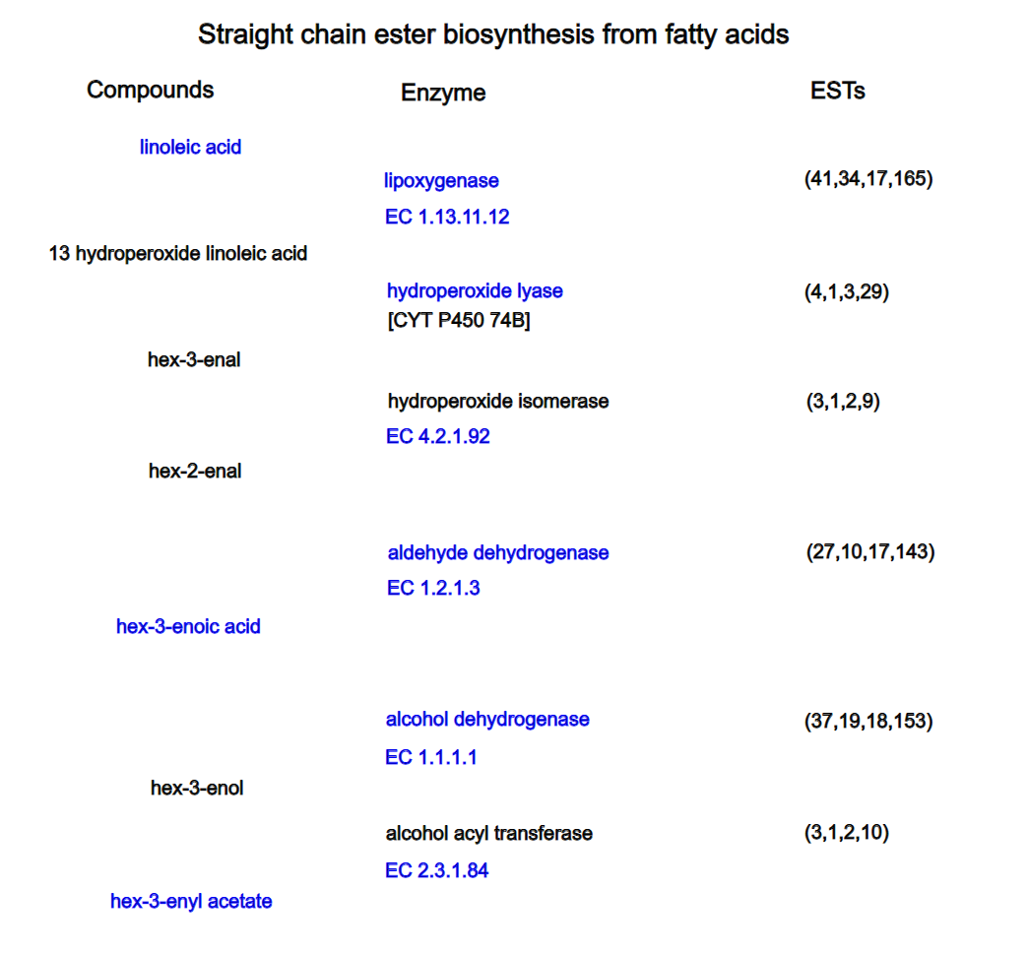
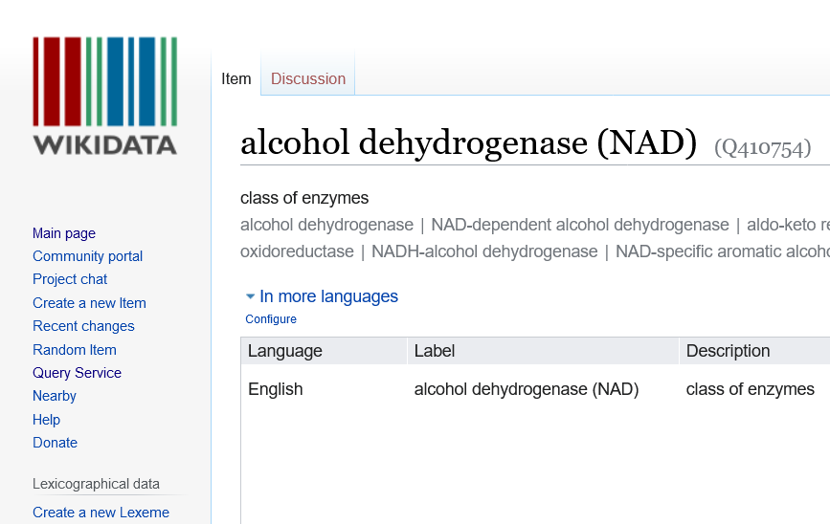
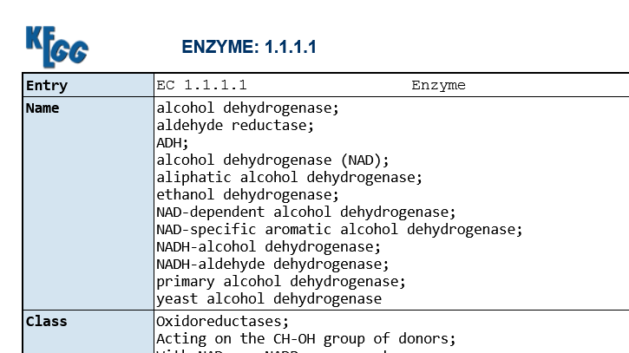
Automatic hyperlinks

Slide 13
Arrows in Pathways
Substrate
Tail of the arrow
Enzyme
Perpendicular to the arrow shaft
We add context to the arrows
Product
Head of the arrow

Slide 14
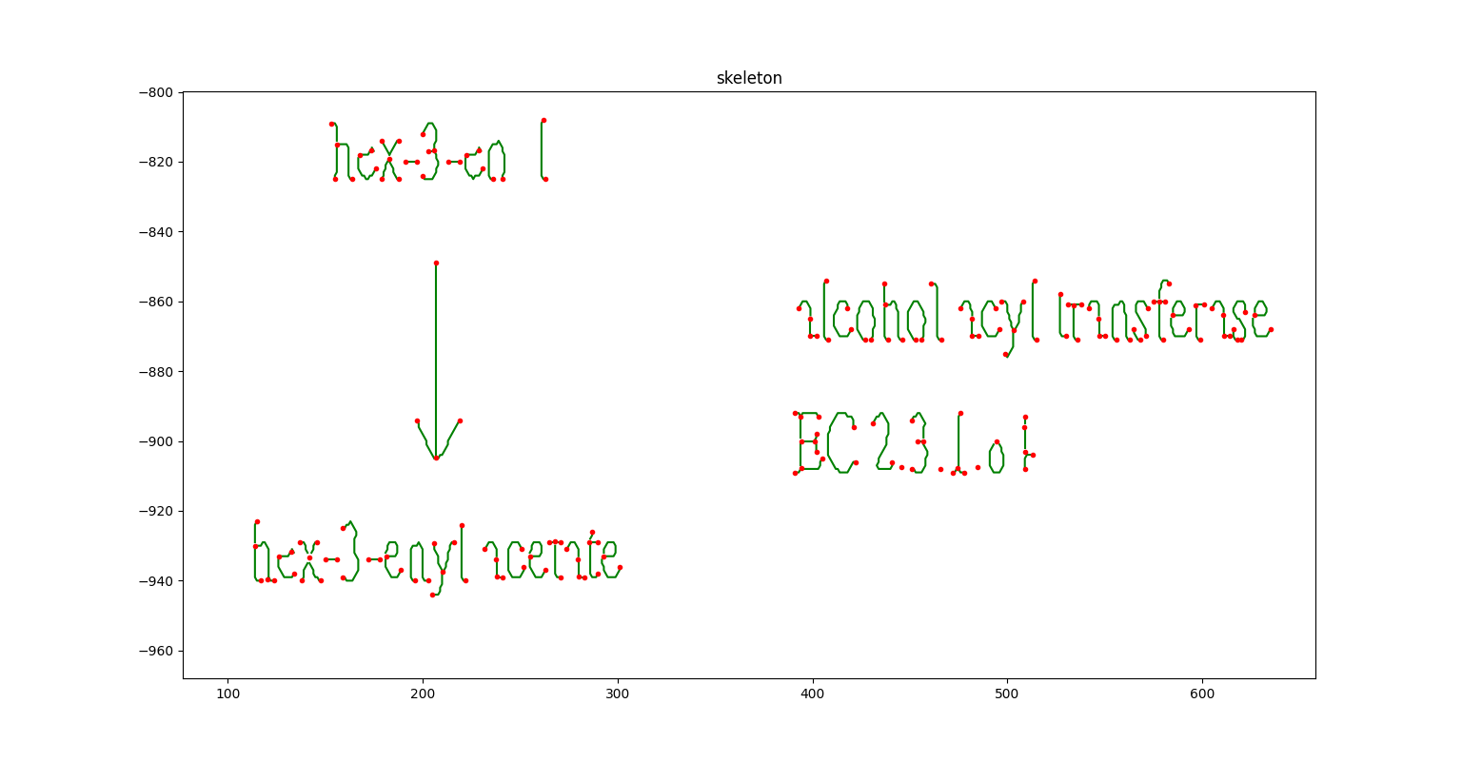
Invert ~> Binarize ~> Skeletonize skimage + Image-Py / sknw
IMAGE
Geometric
Arrow detection

Slide 15
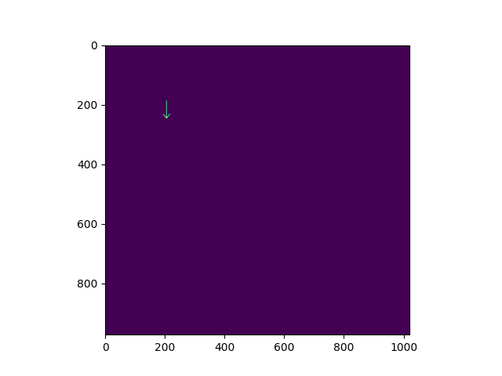
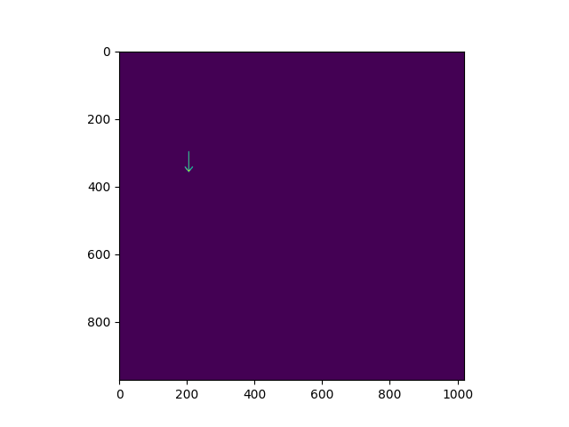
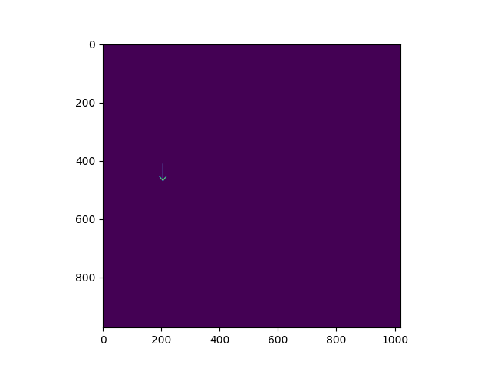
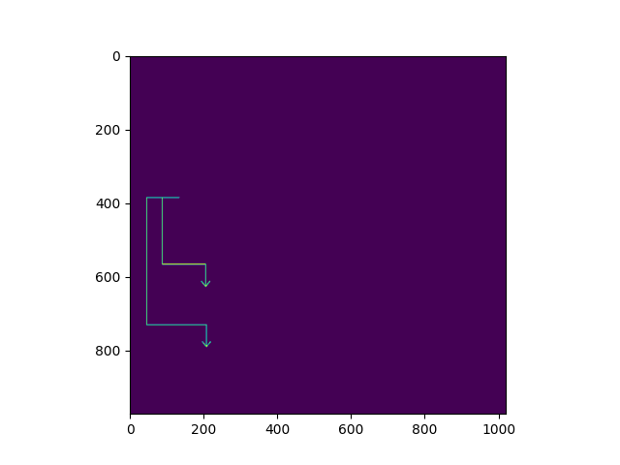

Automatic detection of Arrows

Slide 16
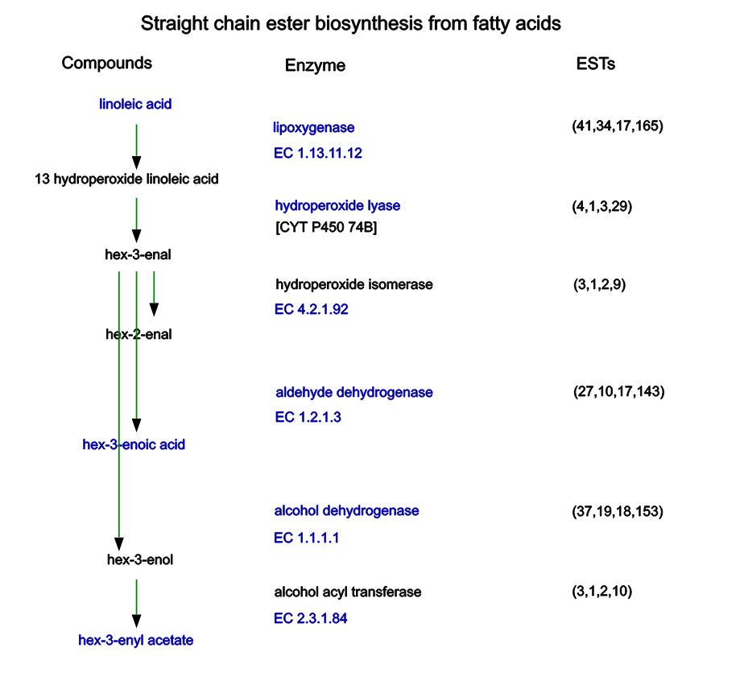
SVG with links embedded in the text and arrows
Conversion to CMLReact
will be automatic

Slide 17

The code for
can be found in:
Thank you for listening!
Find us in Github
Github: @anuvc
IMAGE
petermr / pyamiimage

Slide 18
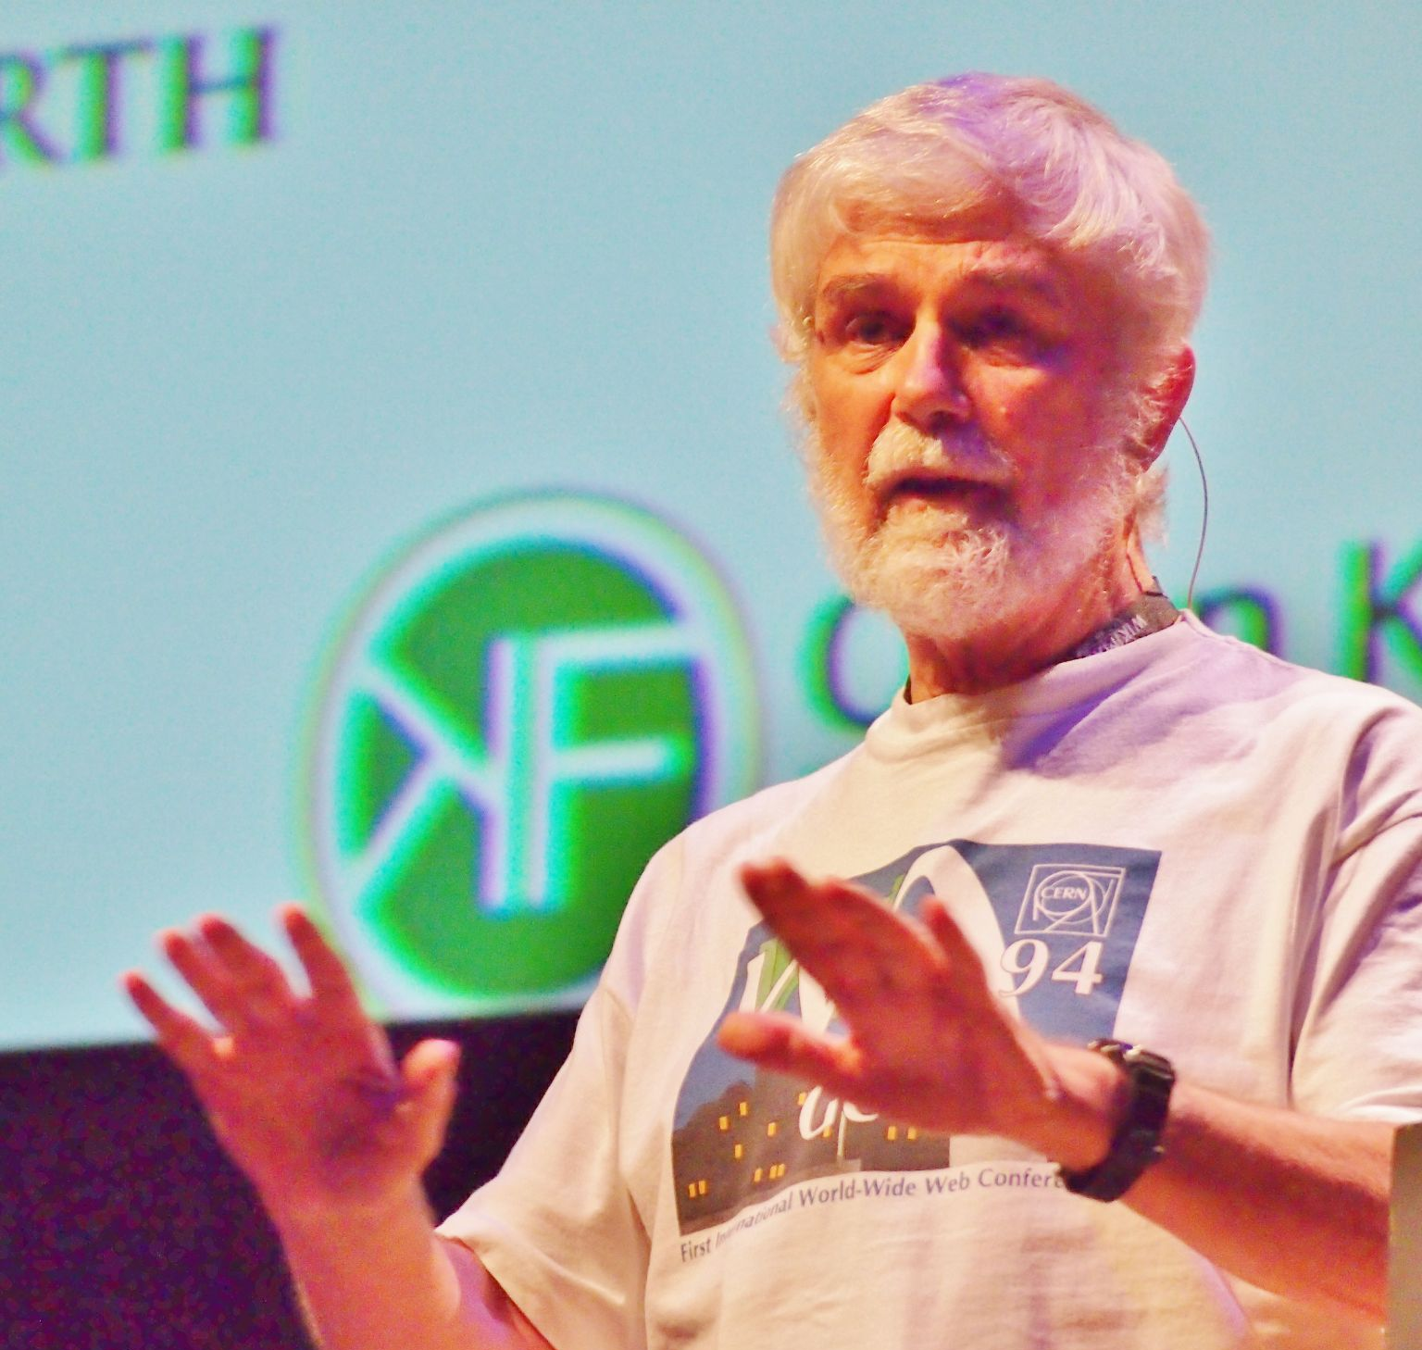

Thanks to my mentors!
Dr. Peter Murray-Rust
Dr. Gitanjali Yadav
Github: @petermr
Github: @gilienv

